Slide 1
Unit 3
Early Detection is very IMPORTANT!

Slide 2
Importance of Early Detection
3 levels of disease and injury
Primary Prevention – Behaviors you can do now.
Secondary Control – Early Detection (Medical Exams/Self-Exams
Tertiary – Treatment Level
Cancer – greatest hope for a cure is early detection – to get treatment that is lifesaving.

Slide 3
Cancer
Breast (Women/Men)
Colon (Women/Men)
Rectal (Women/Men)
Cervix (Women)
Prostate (Men)
Testicle (Men)
Oral Cavity (Women/Men)
Skin (Women/Men)

Slide 4
ACS - 7 Warning Signs of Cancer
Change in Bowel or Bladder Habits
Sore that does not heal
Unusual Bleeding or discharge
Thickening or lump in Breast or elsewhere
Chronic Indigestion or difficulty in swallowing
Obvious change in wart or mole
Nagging Cough or Hoarseness

Slide 5
Stages of Prevention
Primary Prevention
Exercising 2-3 times a week
Low fat/caloric diet
Avoiding tobacco products
Washing hands
Using sunscreen
Wearing seat belt
Brushing your teeth
Secondary Control
Breast Exam
Noticing 7 warning signs of Cancer
Getting a physical once a yr.
Self –Examinations
Going to the dentist – every 6 months

Slide 6
Tertiary Control
Heart Surgery
Tumor removed
Antidepressant Medication
Cast to a broken bone
Tooth removed due to decay
AIDS Medication
Antibiotic for infection

Slide 7
Skin Cancer – Deadliest Skin Cancer = Melanoma
Signs & Symptoms
Asymmetry – 1 half unlike the other
Border – Irregular
Color – Varies between others
Diameter – Larger than ¼
Elevated, Firm, Growing

Slide 8
Melanoma
Most common cancer in the mid 20’s
Prevented with Self-Detection
Risks:
1. Tanning Beds
2. Severe Sun Burns under the age of 20
3. Have 50 or more moles on body
4. Light eyes (blue), freckles, red or blonde hair
Family History of Skin Cancer
UVB rays are the strongest
Use at least SPF 15!

Slide 9
PREVENTION
Seek Shade – 10 am-4pm
Slip on a Shirt
Slop on Sunscreen
Slap on a hat
Wear Sun glasses
Monthly self-exam

Slide 10
TERMS
Malignant – Cancerous
Benign – Non-Cancerous
Metastasizes – Cancer spreads to another body part
Melanin – Skin coloring or pigment
115,000 new cases in 2010

Slide 11
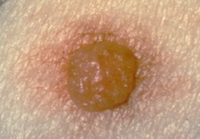
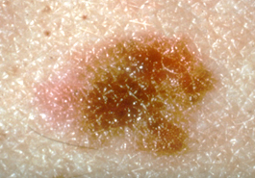
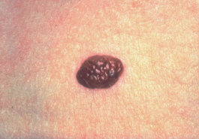
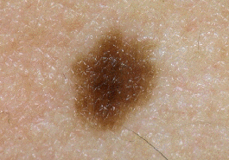
Which Moles are Ordinary Moles?

Slide 12
Resources
Sun Safety
Safety
Skin Cancer Commercial
Slip, Slop, Slap PSA

