Slide 1
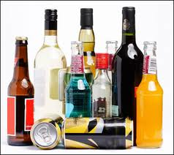
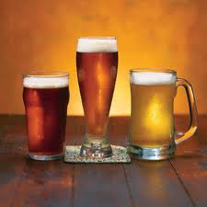
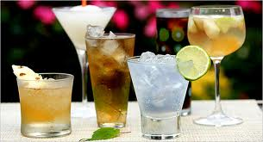
I will investigate the effects of alcohol.
9.ATOD2.2: I will demonstrate strategies for avoiding binge drinking
9.ATOD2.1: I will identify ways to avoid riding in the car or other risky behaviors with someone who is under the influence

Slide 2
“Just One Drink”
There's a small cross by the side of Highway 128, near the town of Boonville. If this cross could talk, it would tell you this sad story: Seven years ago my brother, Michael, was at a friend's ranch. They decided to go out for dinner. Joe arrived and volunteered to drive - after just one drink. Lightheartedly, the four friends traveled the winding road. They didn't know where it would end - nobody did. Suddenly, they swerved into the opposite lane, colliding with an oncoming car. Back home we were watching E.T. on video in front of a warm fire. Then we went to bed. At 2:00 A.M. a police officer woke my mom with the devastating news. Michael had been killed. In the morning, I found my mother and sister crying. I stood there bewildered. "What's wrong?" I asked, rubbing my sleepy eyes. Mom took a deep breath. "Come here..." Thus began a grueling journey through grief, where all roads lead to nowhere. It still hurts to remember that day. The only thing that helps is telling my story, hoping you will remember it if you are tempted to get into a car with someone who has had a drink - even just one drink. Joe chose the road to nowhere. He was convicted of manslaughter and served time. However, the real punishment is living with the consequences of his actions. He left us with an ache in our hearts that will never go away, a nightmare that will haunt him - and us - for the rest of our lives. And a small cross by the side of Highway 128.
Chris Laddish
Dedicated with love to the memory of Michael Laddish

Slide 3
Read and Reflect
Choose 1 and Write your answer on page 36.
Scholar:
What are the consequences to alcohol use and abuse?
Collegiate:
How does alcohol use and abuse affect others?
Genius:
What is the impact of having an alcoholic in the family and what impact might it have on their future generations?

Slide 4
Legal Consequences
What is the legal driving while impaired (DWI) limit (over 21)?
0.08 Blood Alcohol Level
What is the legal BAC for a person under 21?
0.00 Blood Alcohol Level
Can a person be arrested and charge with a DWI if their BAC is below 0.08?
Yes, police just has to prove driving was impaired (observe driving, roadside sobriety test, administer BAC test)
What are the legal consequences of a DWI conviction for a teen?
Loss of driver’s license until age 18, Fine, Court costs, Lawyer fees, Community service, Car insurance triples

Slide 5
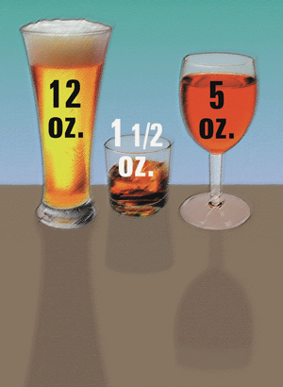
What is a drink?
One 12-ounce beer
One 4- to 5-ounce glass of wine
One 1.5-ounce shot of 80-proof liquor
Ethanol is the type of alcohol found in an alcoholic drink.
What is Fermentation?
All equal one drink.

Slide 6
1. Speed of drinking
- quicker = more intoxicated
2. Presence of food in the stomach
- empty stomach = more intoxicated
3. Body Weight
- lighter person = more intoxicated
4. Drinking History/Tolerance
- little tolerance = more intoxicated
5. The drinker’s expectations
- expect to get drunk = more intoxicated
7. Emotional and physical health
- poor health = feel negative effects of alcohol
8. Gender differences
- female = more intoxicated (due to more body fat)
9. Other drugs
- mix alcohol with drugs = potential for deadly effects

Slide 7
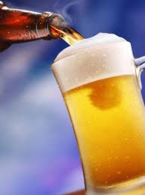
Effect on the body- Depressant
Low Doses:
Relaxing effect, Slowed reflexes, Reduced Coordination
Medium Doses:
Slurred speech, Drowsiness, Altered emotions
High Doses:
Vomiting, Breathing difficulties, Unconsciousness, Coma, Death

Slide 8
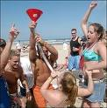
What are 3 ways to avoid riding in a car with someone who is under the influence?
50% of people under the age of 21 drink to get wasted!
Binge drinking: heavy consumption of alcohol in approximately 2 hours
Men: 5 or more drinks
Women: 4 or more drinks
Do teens feel the pressure to drink large amounts of alcohol? (Pg 36)
1. What are 3 strategies to avoid binge drinking?
2. What are 3 ways to avoid riding in the car with a friend who has consumed alcohol?

Slide 9
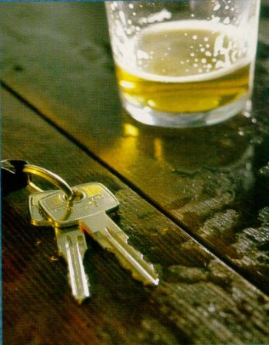
Class Discussion
What poor decisions are made while under the influence of alcohol?

Slide 10
What is the problem?

Slide 11
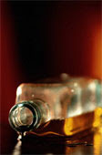
What is the problem?
Sexual Abuse: 97,000 students between the ages of 18 and 24 are victims of alcohol-related sexual assault or date rape.
Unsafe Sex: 400,000 students between the ages of 18 and 24 had unprotected sex and more than 100,000 students between the ages of 18 and 24 report having been too intoxicated to know if they consented to having sex .

Slide 12
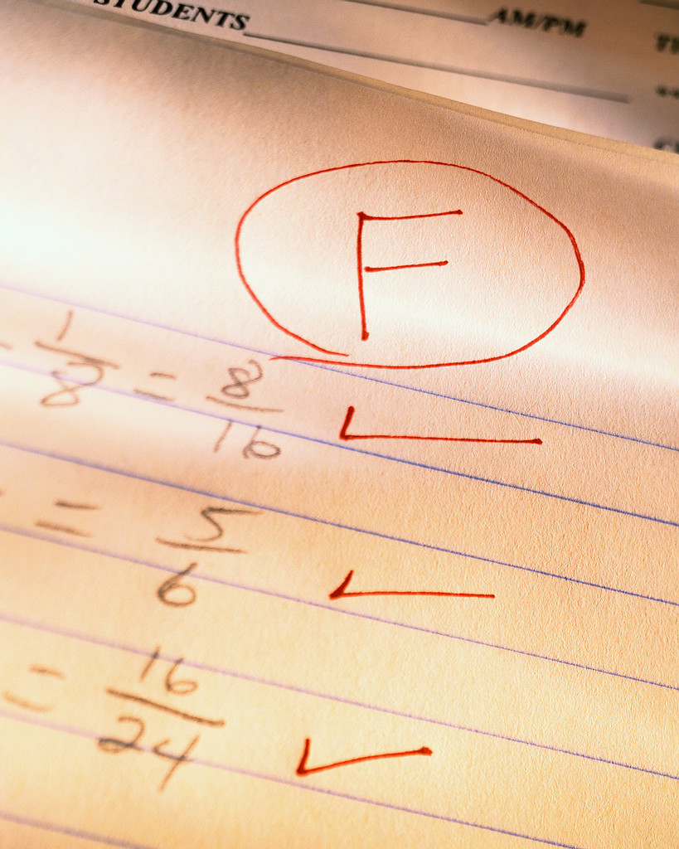
What is the problem?
Academic Problems: About 25 percent of college students report academic consequences of their drinking including missing class, falling behind, doing poorly on exams or papers, and receiving lower grades overall.
Homicide and Suicide Attempts: Alcohol use was involved in 50% of all suicides and homicides.

Slide 13
Unconscious and cannot be awakened
Hypothermia: cold, clammy, unusually pale or bluish skin
Slow breathing: 10 seconds or more btw breaths
Irregular breathing: fewer than 8 breaths per minute
Seizures
Mental Confusion
Vomits while passed out and does not wake up during or after vomiting

Slide 14
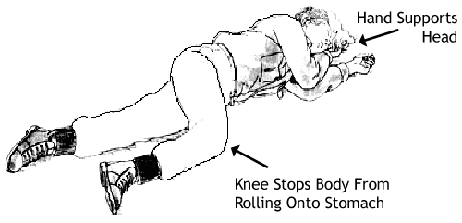
Call 911
Know the danger signs
Do not wait for all symptoms to be present
Perform CPR if needed
Turn person on their side so she/he does not choke on vomit
Do not leave the individual

Slide 15
Jane, a 17 year-old student, is at a party with some friends. At 11:45pm, Jane realizes that she needs to be home by midnight. If she is late, her parents will question her and realize that she has consumed alcohol. Jane decides to drive home…
What happened next? Write answer on page 36 (1 paragraph).

Slide 16
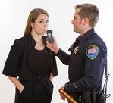
Jane was pulled over for speeding and received a DUI. Her license was suspended for 3 years. Due to her felony, she had a difficult time getting into an in-state college. She ended up going to an out-of-state college, which cost her an additional $20,000 in tuition.
What could Jane have done instead of driving under the influence?

