Slide 1
Organ Donation
9.PCH.1.2: Summarize the procedures for organ donation, local and state resources, and benefits

Slide 2
Annabella
When I think about what donation means to our family, all I can think about is the second chance that our daughter, Annabella, received at life. When she was just a couple of months old, we were told that she was in need of a liver transplant in order to have a normal life. This was devastating news to hear, but we were confident that one day a stranger could give the precious gift of life. Our prayers were answered on February 17, 2010, as she received her second chance, and for that we are so thankful. Donation has enabled Annabella to thrive; she can now play and learn for hours without having to stop and rest. Transplantation is a long and hard process to go through, but without caring and dedicated people, second chances could not be given.

Slide 3
Here are the facts!
More than 80,000 people are on the national transplant waiting list right now.
Sadly, more than 6,000 of these people will die this year while waiting for an organ to become available.
A new name is added to the list every 13 minutes.
One organ and tissue donor can save or improve the lives of 50 or more people.
http://www.youtube.com/watch?v=UqB0HfmduSY

Slide 4
Who can be a donor?
Donor come in all ages and levels of health. Newborns and the elderly can be donor.
Donors are generally in good health and have died suddenly. The y have been declared “brain dead.”
People who have tested positive for HIV can not be donors.

Slide 5
Living Donors
Living individuals can donate the following:
Kidney
Partial liver
Partial lung
Partial pancreas
Bone marrow
Blood

Slide 6
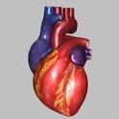
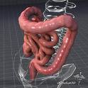
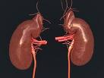
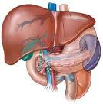
What organs can be donated?
Heart
Intestines
Kidney
Liver
Lung
Pancreas

Slide 7
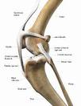
What tissues can be donated?
Blood
Bone
Cornea
Heart valve
Saphenous vein
Ligament and tendons
Skin

Slide 8
The Accident
Mary was driving home from soccer practice with friends when the car accident happened…..
She was severely injured. This is what happened next…

Slide 9
The Donation Process
1. Mary was rushed to the hospital with massive head injuries. Every attempt was made to save her life.
2.Her brain continued to swell and by 4 am she was pronounced brain dead.
3. At that time, the hospital and organ donation agency offered Mary’s parents the option of donation.
4. Her family members discussed their feeling about donation. They remembered that when Mary got her license, she told them that she wanted to be a donor.
5. Mary’s parents gave their written consent for Mary to become a organ/tissue donor……

Slide 10
The Donation Process
6. Mary body was maintained on a ventilator and stabilized with fluids and medications while tests were completed to assess which of her organs were suitable for transplant
7. The surgical teams from the transplant centers receiving the organs were coordinated to arrive at the hospital for the organ recovery surgery.
8. Mary was taken to the operating room. Her organs were removed, cooled and preserved with a special solution while the transplant teams immediately returned to their hospitals to perform the transplant surgeries.
9.Mary’s body was sent to the funeral home.
10. Mary’s family received general information about the recipients of her donated organs and tissues.

Slide 11
Procedure for organ donation
Pronounced dead
Continues to stay connected to machines which will keep healthy organs alive
Hospital and organ donation agency will offer the option of organ donation. Additional consent is needed by a family member
Tests are completed to assess what organs and tissues are healthy for transplant
Surgical teams from the transplant centers receiving the organs arrive for organ recovery surgery.
Patient is taken to the operating room where organs and tissues are removed, cooled, and preserved with a special solution
Transplant teams immediately return to their hospital to perform the transplant surgeries on the recipients.
Body is sent to funeral home
Family will receive general information about the recipients of organs and tissues, excluding name

Slide 12
Local and State Resources
OPO (organ procurement organization):
local organization contacted by the hospital to organize the organ donation process.
UNOS (United Network for Organ Sharing):
Maintains the national transplant waiting list
Receives information on organs/tissues healthy for transplant and matches potential recipients

Slide 13
Benefit of Organ Donation
One donor can save up to eight recipients and enhance the lives of 50 others
Saves lives
Allows someone to have a better quality of life
Helps further medical research which indirectly saves and improves lives
This allows scientists and doctors to understand certain diseases and their effect on the human body.
Helps grieving families

Slide 14
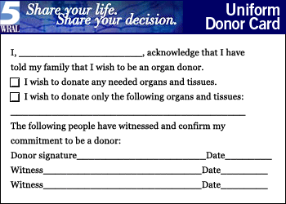
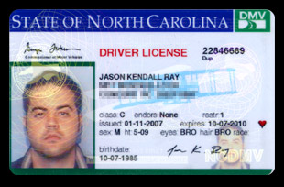
Want to be a donor?
There are two ways to become a donor:
1. At the DMV when getting a driver’s license
2. Online registration website http://www.donatelifenc.org/

Slide 15
Video Clip: License to Give
As you watch the video, imagine yourself or a loved one in need of an organ.
http://www.youtube.com/watch?v=7L6AD-jVjNA
When you get your license, say “Yes” to organ donation.

